Slide 1

Benign ovarian tumors - Part 2 –Content : borderline / benign and malignant ovarians – how to differentiate .
Dr Sangeetha Menon
Assoc Prof Dept of OB- GYN
GMC Kollam

Slide 2
Borderline ovarian tumors
Specific to epithelial ovarian tumors
Neither benign or totally malignant – of low malignant potential
Occur in the younger age group
Histological hallmarks are : nuclear atypia, chromatin condensation , pseudostratification and epithelial proliferation but absence of true stromal invasion .
Remain confined to the ovary for long periods but have a propensity to metastasize
Usually a post op diagnosis with good prognosis

Slide 3
BOT
Can treat conservatively with unilateral oophorectomy if child bearing is required – with complete surgery after childbirth

Slide 4
How do you differentiate benign from malignant ovarian tumors ?

Slide 5
Benign vs malignant
Benign
Malignant
Younger
Present with mass abdomen/ pain / but no loss of appetite or weight
No significant family history
Older
Can present with mass abdomen/ distension or pain but usually have cachexia , loss of weight etc
Can have a positive family history of endometrial , breast or colonic cancer

Slide 6
Benign vs malignant
Benign
Malignant
Clinically the mass is wholly cystic, mobile, and there is no ascites
On ultrasound, the mass is cystic, has a thin cyst wall , few thin septations if any, no ascites and the doppler shows no increased flow
Tumor markers negative
The mass has a varying consistency, is solid and cystic, may be fixed and usually have ascites
The mass has solid areas , the cyst wall is thick , septations are thick and vascular, ascites is seen and doppler shows a characteristic low resistance increased flow typical of neovascularization.
Positive tumor markers

Slide 7
An MRI / CT is often asked for..
It confirms the findings of USG
Sheds light on lymph node status
Helps in judging operability by looking for adherence to adjacent organs, vessels , omental deposits etc.

Slide 8
Three cardinal features of malignancy:
Bilaterality
Ascites
Solid areas

Slide 9
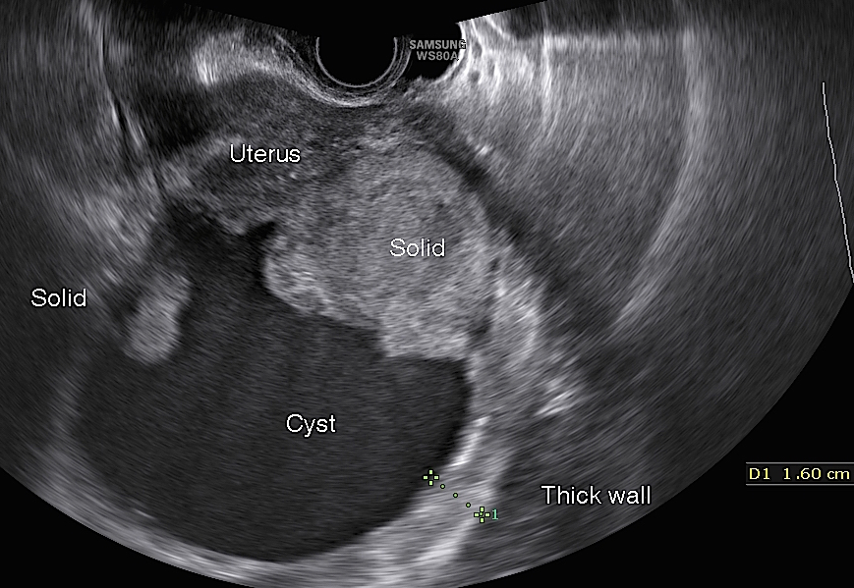

Slide 10
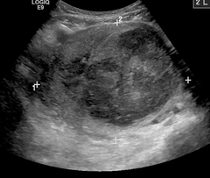

Slide 11
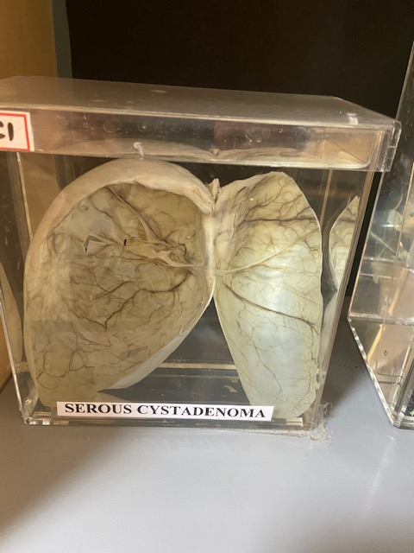

Slide 12
B rules - IOTA
Unilocular cysts
Presence of solid areas where the largest solid component is<7 mm
Presence of accoustic shadowing
Smooth multi locular tumor with largest dia <10 cms
No blood flow

Slide 13
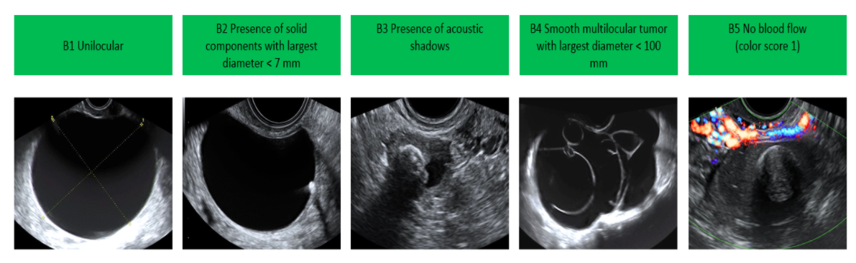

Slide 14
Simple cyst
Round/oval in shape
Thin/imperceptible wall
Posterior accoustic enhancement
Anechoic fluid
Absence of septations / nodules

Slide 15
M rules
Irregular, solid tumor
Ascites
At least 4 papillary structures
Irregular multilocular solid tumor with largest dia > 10 cms
Very strong blood flow

Slide 16
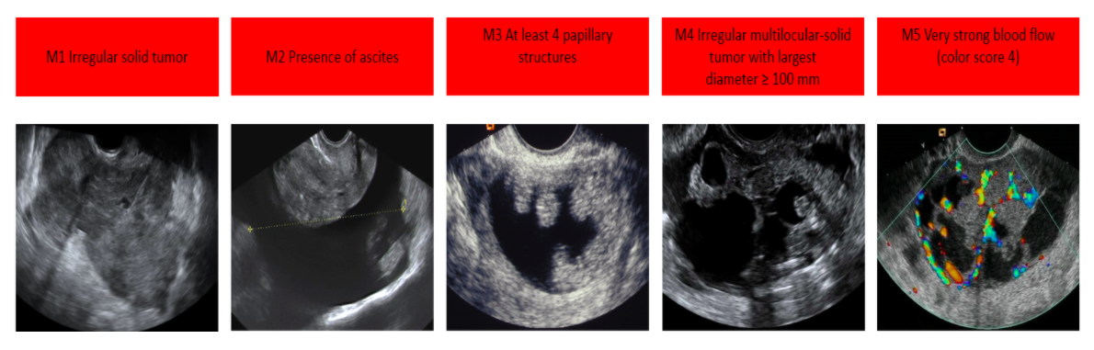

Slide 17
Complex cyst
Complete septations / multi locular cyst
Solid nodules
Papillary projections

